Slide 1
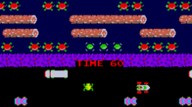
Frogger AI
Team 11 - Lazbin, Sarah; Barnum, Benedict; Ramirez, Juan

Slide 2
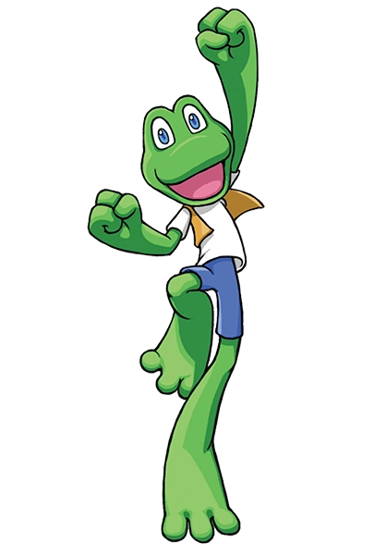
Task Breakdown
Juan - website
Sarah - game development
Benedict - AI development

Slide 3
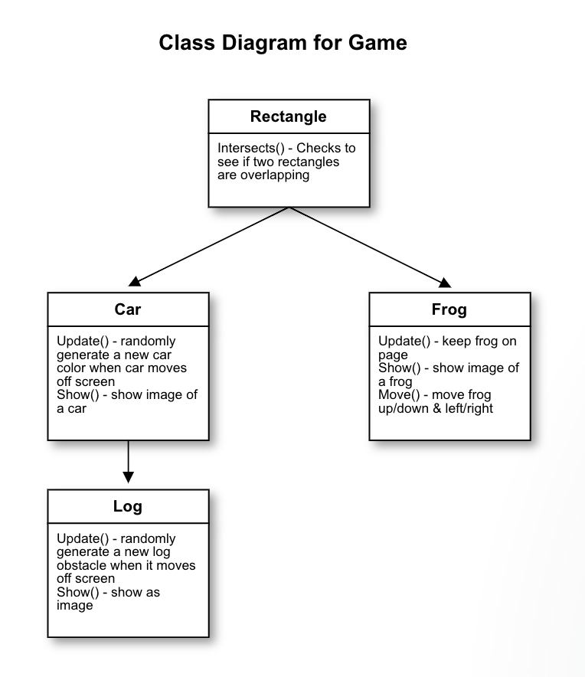
Game CRC Diagram
Frog
Rectangle
Car
Log

Slide 4
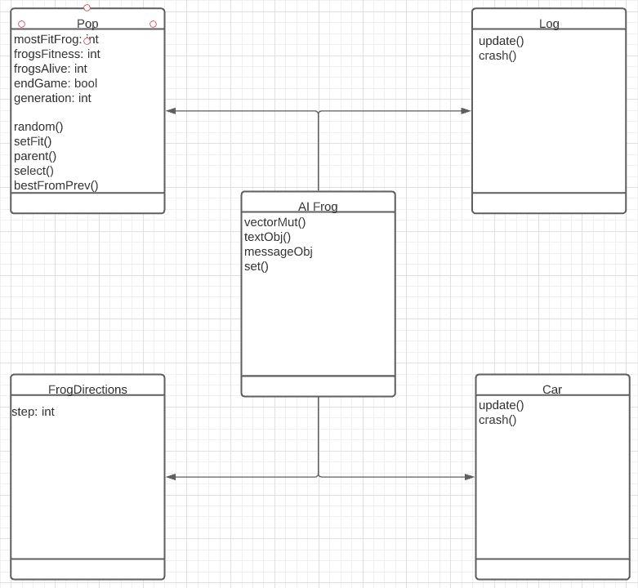
AI CRC Diagram

Slide 5
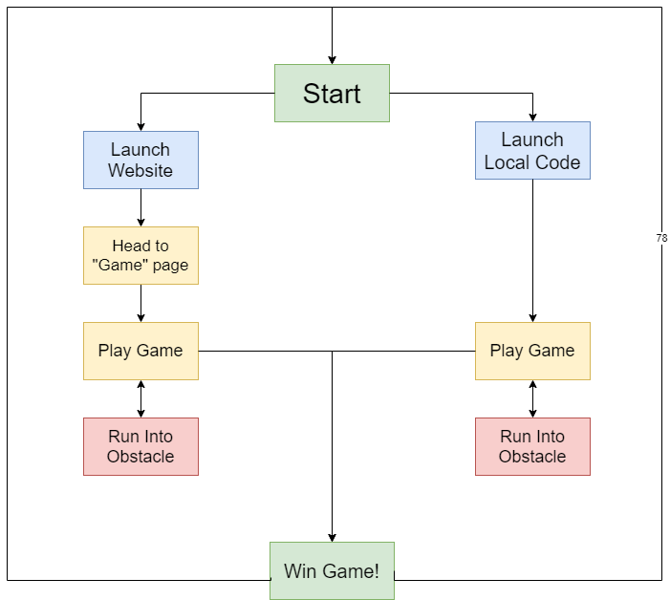
Activity Diagram

Slide 6
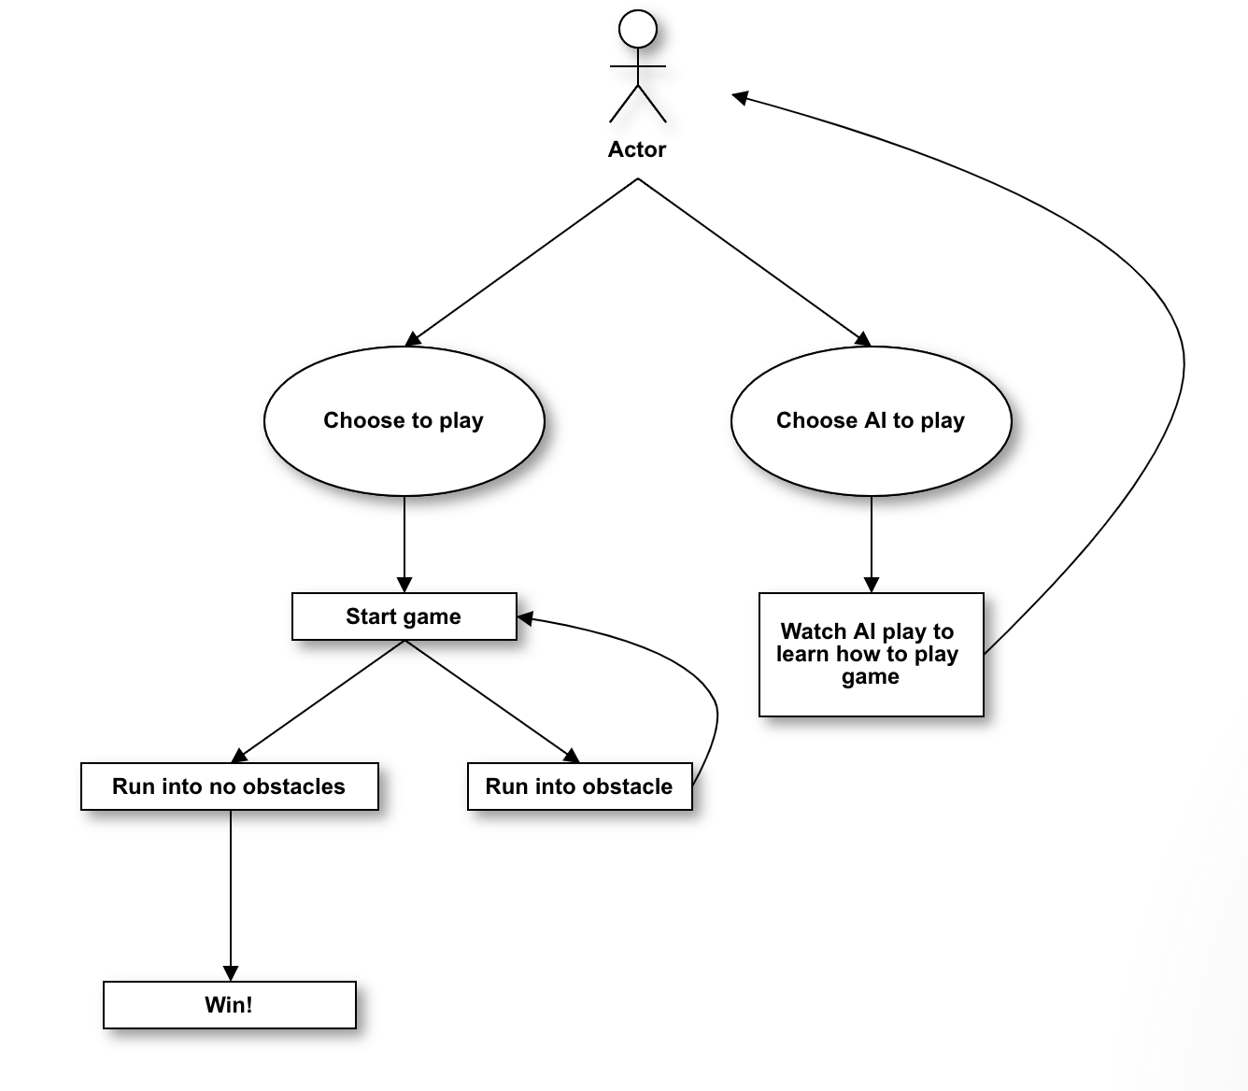
Use Case Diagram

Slide 7
How the Algorithm Works

Slide 8
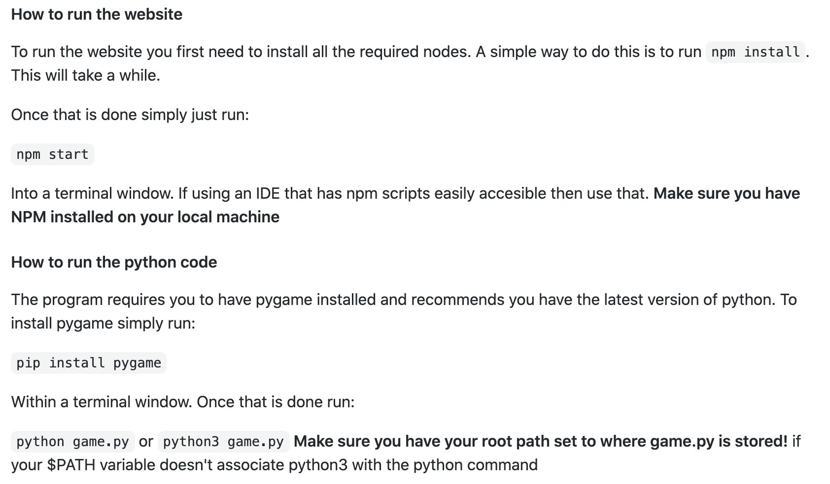
Instructions on how to run

Slide 9
Test Case #1
Test Case Description:
Test to see if frogger can move freely (up, down, left , right) throughout the canvas.
Result:
Pass

Slide 10
Test Case #2
Test Case Description:
Test collision of frogger with moving Objects
Update:
Test collision again of frogger with moving objects after fixing class object algorithm
Result:
Fail: bug - frogger does not reset after crashing
Pass

Slide 11
Test Case #3
Test Case Description:
AI using best fit frog, growing its algorithm, to complete the game
Update:
Testing AI in river to land on objects
Result:
Pass and fail (does not crash in the river)
Update:
Pass

